Slide 1
CDStacks
INT1059-B18 Advanced Web
Online CD Store Website
By Paulo Marchese & Quoc Cuong

Slide 2

The Idea
A Website that sell music CDs
Target user: People who age range from 15 to 35
People who like music.

Slide 3
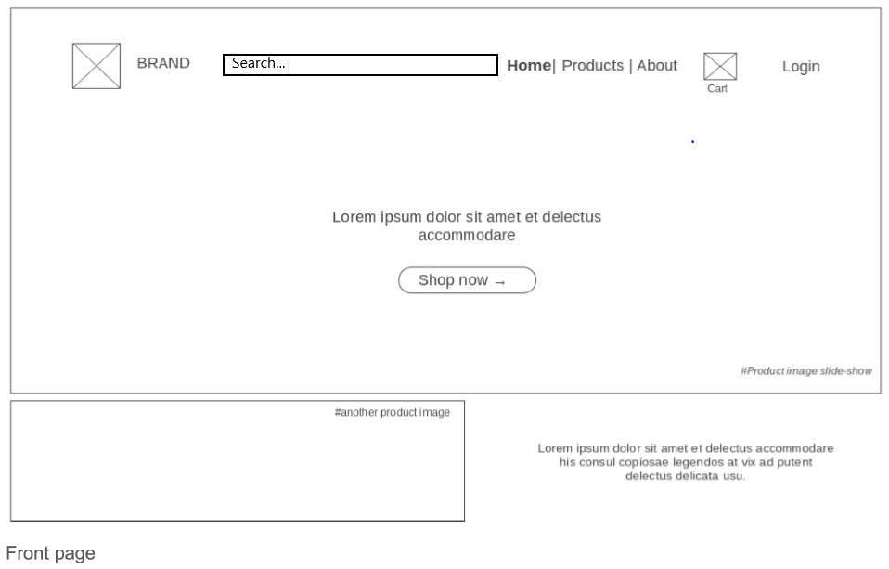
The Plan
Wireframes
Notes:
Explain your layout briefly
Vertical or horizontal navigation?
Search bar?
Login form?
Content / Promotions/ Features/ Special?
Footer content?

Slide 4
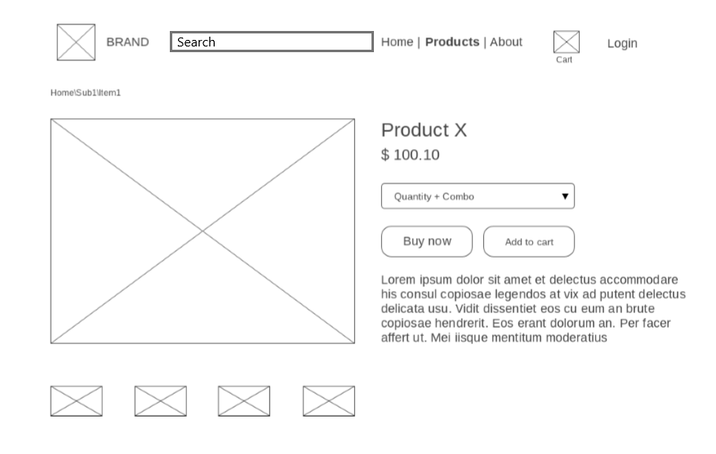
The Plan
Wireframes
Notes:
Explain your layout briefly
Vertical or horizontal navigation?
Search bar?
Login form?
Content / Promotions/ Features/ Special?
Footer content?

Slide 5
The Design
Show either your mockups or a few screen shots (can be over a few slides)
Explain your colour scheme (eg I chose red as it is a colour used in client's branding and mainly white to keep things minimal)
Explain imageries used in your website

Slide 6


The Process
Process of building the project:
Interface (HTML & CSS)
Graphics and Contents.
Dynamic Contents.
Search & Filter.
Shopping Carts.
Login & Register.
Notes:
Talk about the process of building the project (eg "we worked together and A did the graphics and I did the coding..etc)
How did you collaborate?
Tools
Meetings in or outside of campus
etc

Slide 7
Build
Is your final project different from the plan? It almost always is.
Give examples of some of the differences (2 or 3 major ones or up to 6 small ones)
Why did things change? (short of time, being too ambitious, other factors)

Slide 8
Take Aways
What would you do differently next time?
What were the main challenges about working in a team?
Did you find meeting with your counterpart difficult? (be honest)
Does the division between design and code work in a project?
Did you suffer any loss of assets (eg data or property loss)
other valid points

Slide 9
Q & A
Notes:
Say Goodbye (in a nice way…). Tell us if what you are planning for the future (eg will you launch this project as a real venture? Why/Why not)

